Slide 1
Module 7: Storage
AWS Academy Cloud Foundations
© 2019, Amazon Web Services, Inc. or its Affiliates. All rights reserved.
Notes:
Millions of customers use AWS storage services to transform their business, increase agility, reduce costs, and accelerate innovation. Choose from a broad portfolio of storage solutions with deep functionality for storing, accessing, protecting, and analyzing your data.

Slide 2

Module overview
Topics
Amazon Elastic Block Store (Amazon EBS)
Amazon Simple Storage Service (Amazon S3)
Amazon Elastic File System (Amazon EFS)
Amazon Simple Storage Service Glacier
Demos
Amazon EBS console
Amazon S3 console
Amazon EFS console
Amazon S3 Glacier console
Lab
Working with Amazon EBS
Activities
Storage solution case study
Knowledge check
Notes:
Cloud storage is typically more reliable, scalable, and secure than traditional on-premises storage systems. Cloud storage is a critical component of cloud computing because it holds the information that applications use. Big data analytics, data warehouses, the Internet of Things (IoT), databases, and backup and archive applications all rely on some form of data storage architecture.
This module addresses the following topics:
Amazon Elastic Block Store (Amazon EBS)
Amazon Simple Storage Service (Amazon S3)
Amazon Elastic File System (Amazon EFS)
Amazon Simple Storage Service Glacier
We will use AWS Management Console to create storage solutions.
This module includes a hands-on lab where you create an Amazon EBS volume, and then attach it to an Amazon Elastic Compute Cloud (Amazon EC2) instance. You also create a snapshot of your volume and then use the snapshot to create a new volume.
This module includes an activity that challenges you to determine the best storage solution for a business case.
Finally, you are asked to complete a knowledge check that tests your understanding of the key concepts in this module.

Slide 3
Module objectives
After completing this module, you should be able to:
Identify the different types of storage
Explain Amazon S3
Identify the functionality in Amazon S3
Explain Amazon EBS
Identify the functionality in Amazon EBS
Perform functions in Amazon EBS to build an Amazon EC2 storage solution
Explain Amazon EFS
Identify the functionality in Amazon EFS
Explain Amazon S3 Glacier
Identify the functionality in Amazon S3 Glacier
Differentiate between Amazon EBS, Amazon S3, Amazon EFS, and Amazon S3 Glacier
Notes:
The goal of this module is to discover key concepts that relate to storage. You will learn about the different types of storage resources that are available and review the different pricing options so that you can understand how different choices affect your solution cost.
After completing this module, you should be able to:
Identify the different types of storage
Explain Amazon S3
Identify the functionality in Amazon S3
Explain Amazon EBS
Identify the functionality in Amazon EBS
Perform functions in Amazon EBS to build an Amazon EC2 storage solution
Explain Amazon EFS
Identify the functionality in Amazon EFS
Explain Amazon S3 Glacier
Identify the functionality in Amazon S3 Glacier
Differentiate between Amazon EBS, Amazon S3, Amazon EFS, and Amazon S3 Glacier

Slide 4









Core AWS services
Amazon S3
Amazon EBS
Amazon
EFS
Amazon S3 Glacier
Amazon Virtual Private Cloud (Amazon VPC)
Amazon Elastic Compute Cloud (Amazon EC2)
AWS Identity and Access Management (IAM)
Storage
Amazon Relational
Database Service
Amazon DynamoDB
Database
Notes:
Storage is another AWS core service category. Some broad categories of storage include: instance store (ephemeral storage), Amazon EBS, Amazon EFS, Amazon S3, and Amazon S3 Glacier.
Instance store, or ephemeral storage, is temporary storage that is added to your Amazon EC2 instance.
Amazon EBS is persistent, mountable storage that can be mounted as a device to an Amazon EC2 instance. Amazon EBS can be mounted to an Amazon EC2 instance only within the same Availability Zone. Only one Amazon EC2 instance at a time can mount an Amazon EBS volume.
Amazon EFS is a shared file system that multiple Amazon EC2 instances can mount at the same time.
Amazon S3 is persistent storage where each file becomes an object and is available through a Uniform Resource Locator (URL); it can be accessed from anywhere.
Amazon S3 Glacier is for cold storage for data that is not accessed frequently (for example, when you need long-term data storage for archival or compliance reasons).

Slide 5
Section 1: Amazon Elastic Block Store (Amazon EBS)
Module 7: Storage
Notes:
Amazon Elastic Block Store (Amazon EBS) provides block level storage volumes for use with EC2 instances. ... You can create a file system on top of these volumes, or use them in any way you would use a block device (such as a hard drive). You can dynamically change the configuration of a volume attached to an instance.

Slide 6
Storage
Amazon Elastic Block Store (Amazon EBS)
Notes:
An Amazon EBS volume is a durable, block-level storage device that you can attach to your instances. After you attach a volume to an instance, you can use it as you would use a physical hard drive. EBS volumes are flexible. For current-generation volumes attached to current-generation instance types, you can dynamically increase size, modify the provisioned IOPS capacity, and change volume type on live production volumes.
You can use EBS volumes as primary storage for data that requires frequent updates, such as the system drive for an instance or storage for a database application. You can also use them for throughput-intensive applications that perform continuous disk scans. EBS volumes persist independently from the running life of an EC2 instance.
You can attach multiple EBS volumes to a single instance. The volume and instance must be in the same Availability Zone. Depending on the volume and instance types, you can use Multi-Attach to mount a volume to multiple instances at the same time.
Amazon EBS provides the following volume types: General Purpose SSD (gp2 and gp3), Provisioned IOPS SSD (io1 and io2), Throughput Optimized HDD (st1), Cold HDD (sc1), and Magnetic (standard). They differ in performance characteristics and price, allowing you to tailor your storage performance and cost to the needs of your applications. For more information, see Amazon EBS volume types.
Your account has a limit on the number of EBS volumes that you can use, and the total storage available to you. For more information about these limits, and how to request an increase in your limits, see Amazon EC2 service quotas.
Amazon EBS provides persistent block storage volumes for use with Amazon EC2 instances. Persistent storage is any data storage device that retains data after power to that device is shut off. It is also sometimes called non-volatile storage.
Each Amazon EBS volume is automatically replicated within its Availability Zone to protect you from component failure. It is designed for high availability and durability. Amazon EBS volumes provide the consistent and low-latency performance that is needed to run your workloads.
With Amazon EBS, you can scale your usage up or down within minutes, while paying a low price for only what you provision.

Slide 7

AWS storage options: Block storage versus object storage
What if you want to change one character in a 1-GB file?
Block storage
Object storage
Change one block (piece of the file)
that contains the character
Entire file must be updated
Notes:
Diff between File storage, Block Storage and Object storage :
File storage has been around for considerably longer than object storage and is something most people are familiar with. You name your files/data, place them in folders, and can nest them under more folders to form a set path. In this way, files are organized into a hierarchy, with directories and sub-directories. Each file also has a limited set of metadata associated with it, such as the file name, the date it was created, and the date it was last modified.
This works very well up to a point, but as capacity grows the file model becomes burdensome for two reasons. First, performance suffers beyond a certain capacity. The NAS system itself has limited processing power, making the processor a bottleneck. Performance also suffers with the massive database – the file lookup tables– that accompany capacity growth.
Despite potential issues at scale, filesystems perform fine for day-to-day usage on personal computers and servers used in the workplace and medium to large enterprises. File storage is commonly seen and deployed on hard drives and Network Attached Storage (NAS) systems.
Block Storage, as the name suggests, treats data as a sequence of fixed-size “chunks” or “blocks” in which each file or object could be spread across multiple blocks. These blocks need not be stored contiguously. Whenever this data is requested by the user, the underlying storage system merges the data blocks back together and serves the user request.
This can be achieved without the need for a hierarchical structure because each block has a different and unique address and exists independently of all others. In some cases, block storage can retrieve data very quickly. Block storage is commonly deployed in Storage Area Network (SAN) storage. You can think of block storage as the foundation on which file storage systems are built.
Object storage is a type of data storage in which each unit of data (called an “object”) is stored as a discrete unit. These objects can be virtually any type of data: pdf, video, audio, text, website data or any other file type.
As opposed to file storage, these objects are stored in a single, flat structure without a folder hierarchy. In object storage, all the objects are stored in flat addresses space unlike the nested, hierarchical structure used by file storage. Moreover, all the default and custom metadata are stored with the object itself (not as part of a separate filesystem table or index), in a flat address space with a unique identifier, and in that way becomes easier to index and access.
Object storage is quite common in cloud-based storage scenarios and can be used to manage, process and distribute content with very high scalability and reliability. The flat addressing scheme means that accessing individual objects is fast and easy: object names can serve as “keys” in a lookup table. Object storage systems simply need to know the key (name) of the object you are looking for, and can then return it to you quickly and easily using a lookup table.
--
What happens if you want to change one character in a 1-GB file? With block storage, you change only the block that contains the character. With object storage, the entire file must be updated.
One critical difference between some storage types is whether they offer block-level storage or object-level storage.
This difference has a major effect on the throughput, latency, and cost of your storage solution. Block storage solutions are typically faster and use less bandwidth, but they can cost more than object-level storage.

Slide 8
Amazon EBS
Amazon EBS enables you to create individual storage volumes and attach them to an Amazon EC2 instance:
Amazon EBS offers block-level storage.
Volumes are automatically replicated within its Availability Zone.
It can be backed up automatically to Amazon S3 through snapshots.
Uses include –
Boot volumes and storage for Amazon Elastic Compute Cloud (Amazon EC2) instances
Data storage with a file system
Database hosts
Enterprise applications
Notes:
Amazon EBS enables you to create individual storage volumes and attach them to an Amazon EC2 instance. Amazon EBS offers block-level storage, where its volumes are automatically replicated within its Availability Zone. Amazon EBS is designed to provide durable, detachable, block-level storage (which is like an external hard drive) for your Amazon EC2 instances. Because they are directly attached to the instances, they can provide low latency between where the data is stored and where it might be used on the instance.
For this reason, they can be used to run a database with an Amazon EC2 instance. Amazon EBS volumes are included as part of the backup of your instances into Amazon Machine Images (or AMIs). AMIs are stored in Amazon S3 and can be reused to create new Amazon EC2 instances later.
A backup of an Amazon EBS volume is called a snapshot. The first snapshot is called the baseline snapshot. Any other snapshot after the baseline captures only what is different from the previous snapshot.
Amazon EBS volumes uses include:
Boot volumes and storage for Amazon EC2 instances
Data storage with a file system
Database hosts
Enterprise applications

Slide 9
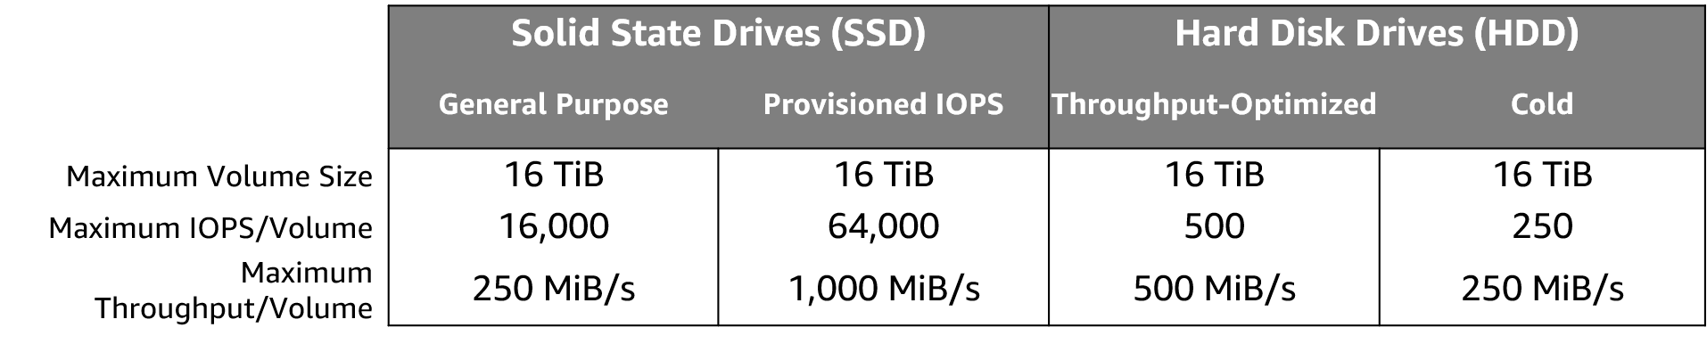
Amazon EBS volume types
Notes:
Amazon EBS provides the following volume types, which differ in performance characteristics and price, so that you can tailor your storage performance and cost to the needs of your applications. The volumes types fall into these categories:
Solid state drives (SSD) — Optimized for transactional workloads involving frequent read/write operations with small I/O size, where the dominant performance attribute is IOPS.
Hard disk drives (HDD) — Optimized for large streaming workloads where the dominant performance attribute is throughput.
Previous generation — Hard disk drives that can be used for workloads with small datasets where data is accessed infrequently and performance is not of primary importance. We recommend that you consider a current generation volume type instead.
There are several factors that can affect the performance of EBS volumes, such as instance configuration, I/O characteristics, and workload demand. To fully use the IOPS provisioned on an EBS volume, use EBS-optimized instances. For more information about getting the most out of your EBS volumes, see Amazon EBS volume performance on Linux instances.
Matching the correct technology to your workload is a best practice for reducing storage costs. Provisioned IOPS SSD-backed Amazon EBS volumes can give you the highest performance. However, if your application doesn't require or won't use performance that high, General Purpose SSD is usually sufficient. Only SSDs can be used as boot volumes for EC2 instances. The lower-cost options might be a solution for additional storage or use cases other than boot volumes.
https://docs.aws.amazon.com/AWSEC2/latest/UserGuide/ebs-volume-types.html

Slide 10
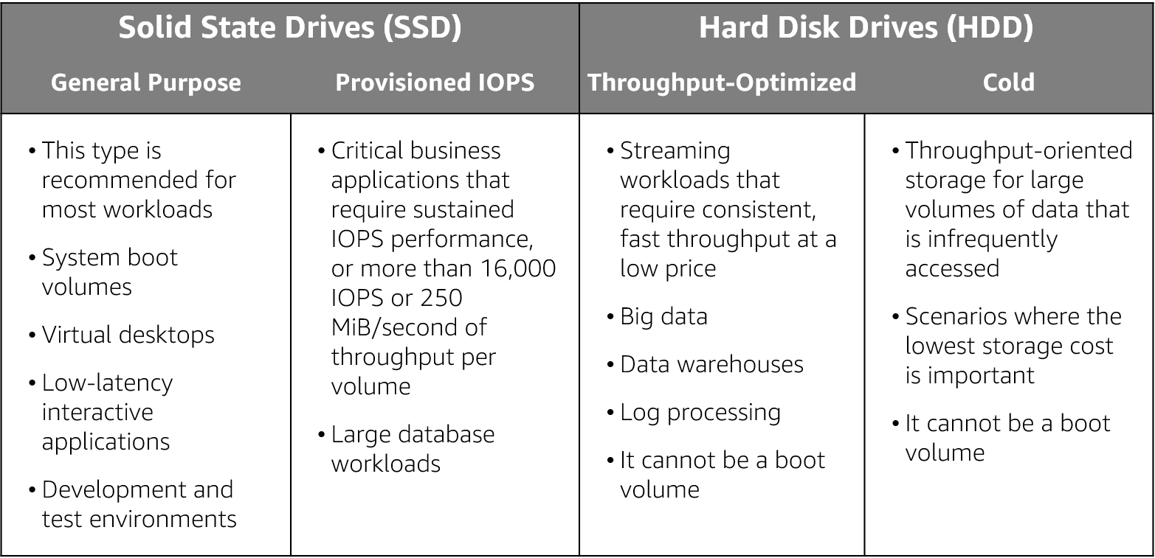
Amazon EBS volume type use cases
Notes:
As mentioned previously an Amazon EBS volume is a durable, block-level storage device that you can attach to a single EC2 instance. You can use Amazon EBS volumes as primary storage for data that requires frequent updates, such as the system drive for an instance or storage for a database application. You can also use them for throughput-intensive applications that perform continuous disk scans. Amazon EBS volumes persist independently from the running life of an EC2 instance.
Use cases for EBS vary by the storage type used and whether you are using General Purpose of Provisioned IOPS.

Slide 11



Amazon EBS features
Snapshots –
Point-in-time snapshots
Recreate a new volume at any time
Encryption –
Encrypted Amazon EBS volumes
No additional cost
Elasticity –
Increase capacity
Change to different types
Notes:
To provide an even higher level of data durability, Amazon EBS enables you to create point-in-time snapshots of your volumes, and you can re-create a new volume from a snapshot at any time. You can also share snapshots or even copy snapshots to different AWS Regions for even greater disaster recovery (DR) protection. For example, you can encrypt and share your snapshots from Virginia in the US to Tokyo, Japan.
You can also have encrypted Amazon EBS volumes at no additional cost, so the data that moves between the EC2 instance and the EBS volume inside AWS data centers is encrypted in transit.
As your company grows, the amount of data that is stored on your Amazon EBS volumes is also likely to grow. Amazon EBS volumes can increase capacity and change to different types, so you can change from hard disk drives (HDDs) to solid state drives (SSDs) or increase from a 50-GB volume to a 16-TB volume. For example, you can do this resize operation dynamically without needing to stop the instances.

Slide 12
Amazon EBS: Volumes, IOPS, and pricing
Volumes –
Amazon EBS volumes persist independently from the instance.
All volume types are charged by the amount that is provisioned per month.
IOPS –
General Purpose SSD:
Charged by the amount that you provision in GB per month until storage is released.
Magnetic:
Charged by the number of requests to the volume.
Provisioned IOPS SSD:
Charged by the amount that you provision in IOPS (multiplied by the percentage of days that you provision for the month).
Notes:
When you begin to estimate the cost for Amazon EBS, you must consider the following:
Volumes – Volume storage for all Amazon EBS volume types is charged by the amount you provision in GB per month, until you release the storage.
IOPS – I/O is included in the price of General Purpose SSD volumes. However, for Amazon EBS magnetic volumes, I/O is charged by the number of requests that you make to your volume. With Provisioned IOPS SSD volumes, you are also charged by the amount you provision in IOPS (multiplied by the percentage of days that you provision for the month).
The pricing and provisioning of Amazon EBS are complex. In general, you pay for the size of the volume and its usage. To learn more about the full, highly complex pricing and provisioning concepts of Amazon EBS, see Amazon EBS volume types.

Slide 13
Amazon EBS: Snapshots and data transfer
Snapshots –
Added cost of Amazon EBS snapshots to Amazon S3 is per GB-month of data stored.
Data transfer –
Inbound data transfer is free.
Outbound data transfer across Regions incurs charges.
Notes:
Snapshots – Amazon EBS enables you to back up snapshots of your data to Amazon S3 for durable recovery. If you opt for Amazon EBS snapshots, the added cost is per GB-month of data stored.
Data transfer – When you copy Amazon EBS snapshots, you are charged for the data that is transferred across Regions. After the snapshot is copied, standard Amazon EBS snapshot charges apply for storage in the destination Region.

Slide 14

Section 1 key takeaways
Amazon EBS features:
Persistent and customizable block storage for Amazon EC2
HDD and SSD types
Replicated in the same Availability Zone
Easy and transparent encryption
Elastic volumes
Back up by using snapshots
Notes:
Amazon EBS provides block-level storage volumes for use with Amazon EC2 instances. Amazon EBS volumes are off-instance storage that persists independently from the life of an instance. They are analogous to virtual disks in the cloud. Amazon EBS provides three volume types: General Purpose SSD, Provisioned IOPS SSD, and magnetic.
The three volume types differ in performance characteristics and cost, so you can choose the right storage performance and price for the needs of your applications.
Additional benefits include replication in the same Availability Zone, easy and transparent encryption, elastic volumes, and backup by using snapshots.
To learn more about Amazon EBS, see: Elastic Block Store.
.

